Slide 1
Web Scraping Project
overwatchleague.com

Slide 2

The Game: Overwatch
Team based First Person Shooter
Team vs Team (Six players each)
31 different “Heros” that fall into 3 different roles (Tank, Damage, Support)
Objective Oriented (Secure Points, Escort Payload)
Top players belong to the “Overwatch League” and compete as Teams

Slide 3
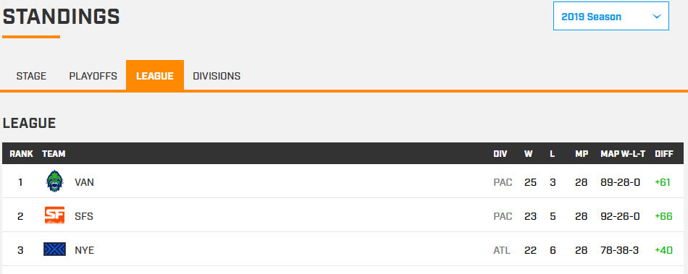
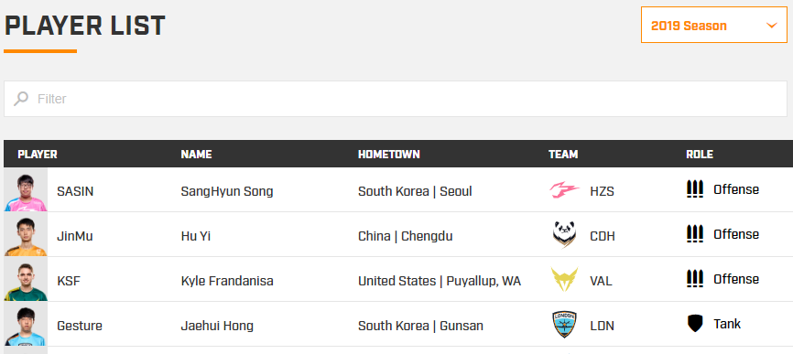
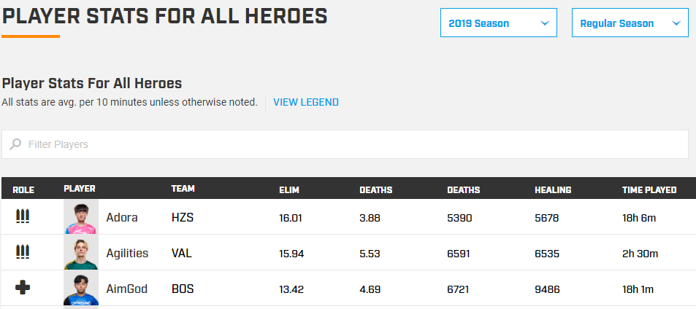
The Data
Three URLs of information regarding players/teams in the Overwatch League
Next Page does not update URL
Selenium Used

Slide 4
Why Do we Care?
Popular online competitive game, with an e-sports following
Numbers based game and statistics (Hit Points, Damage Trades, etc.)
Do any of the statistics predict wins?
Statistics are normally k/d/a based; do they have any value in an objective-based game?
Player Demographics
Role/Class Balance

Slide 5
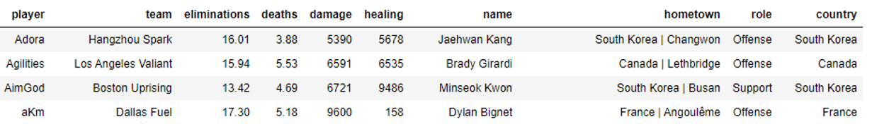
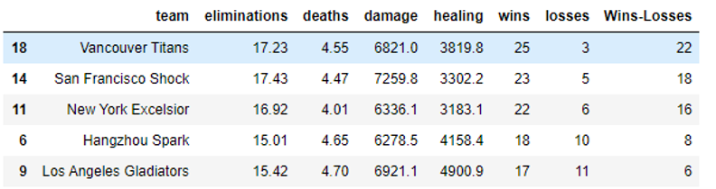
Compiling the Data
Obtained CSV files from each URL
Merged Player List and Player Stats on “Player”
Also grouped these by “Team” and merged with Standings

Slide 6
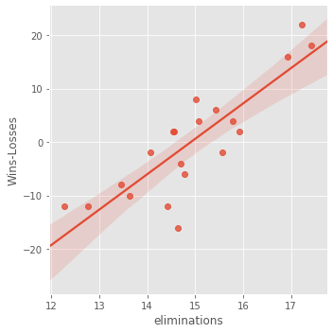
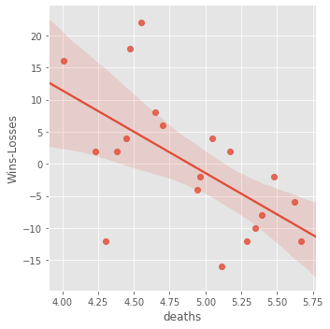
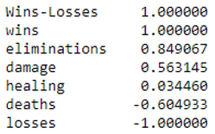
Analysis: Predicting Wins
Sklearn pearson correlation between [eliminations, deaths, damage, healing] and [Wins-Losses]
Seaborn plots with linear model
Eliminations and Deaths do matter even in this objective-oriented game.

Slide 7
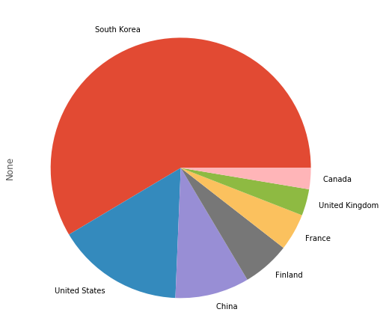
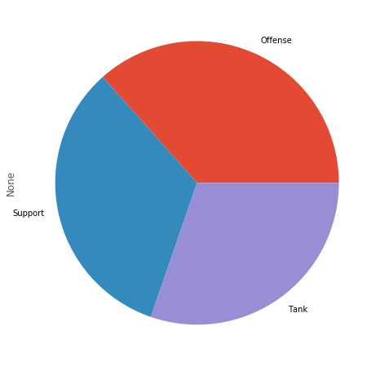
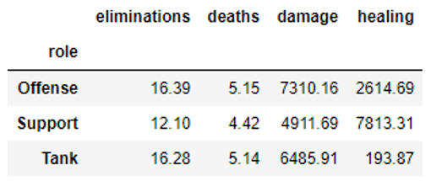
Descriptive Statistics

Slide 8
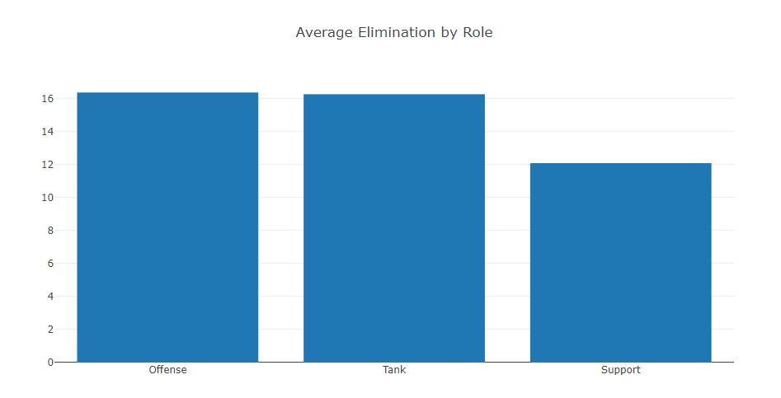
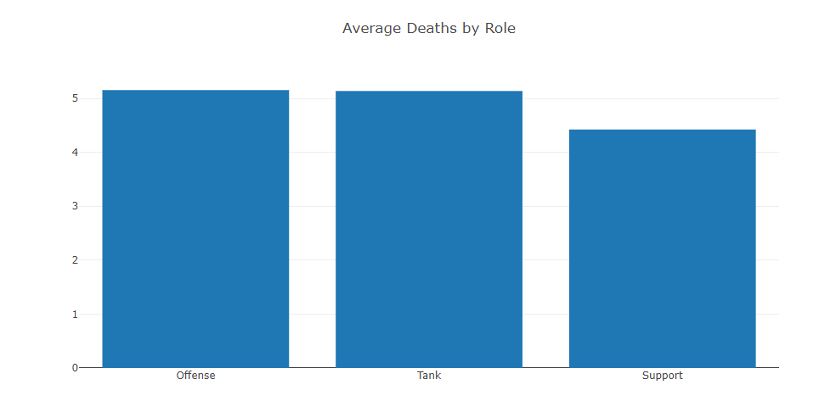
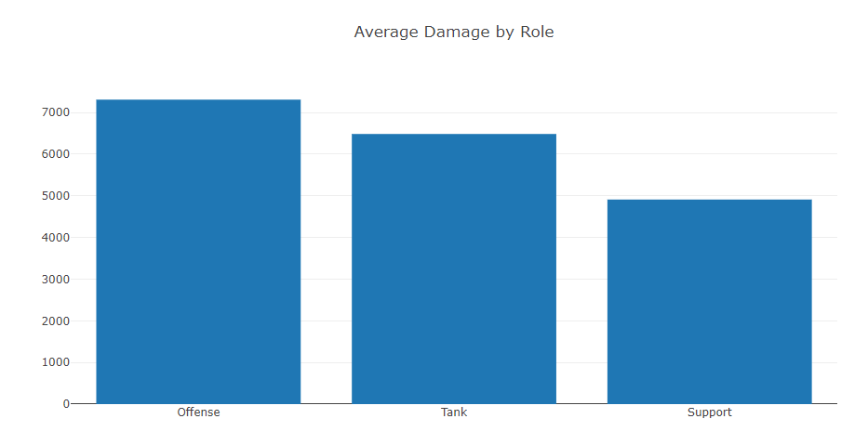
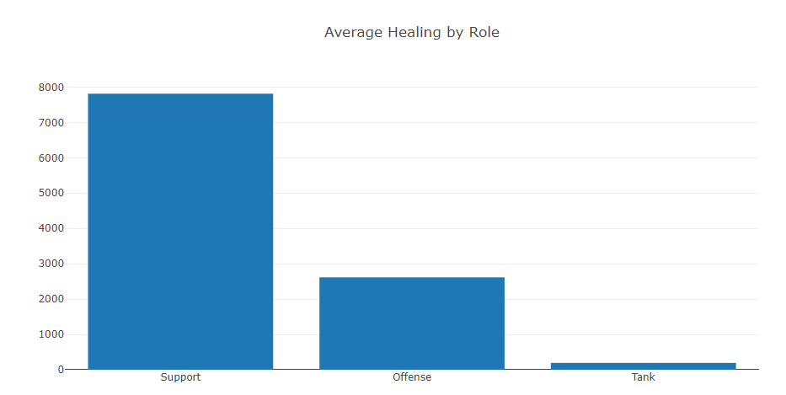
Are Roles Balanced?

Slide 9
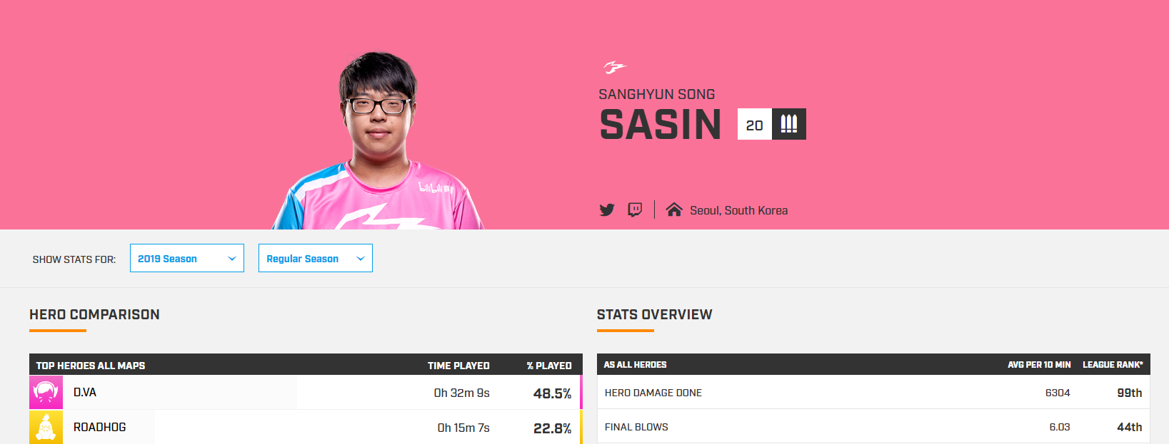
Future Work
Analysis incorporating each individual players top 3 played Heros
Required few clicks into page and then back out for next player, time consuming
Could predict wins based on teams that consist of players with predominantly “mains” or “multi-classers”
More analysis on intra-team dynamics of top teams

Slide 10
End

